Slide 1
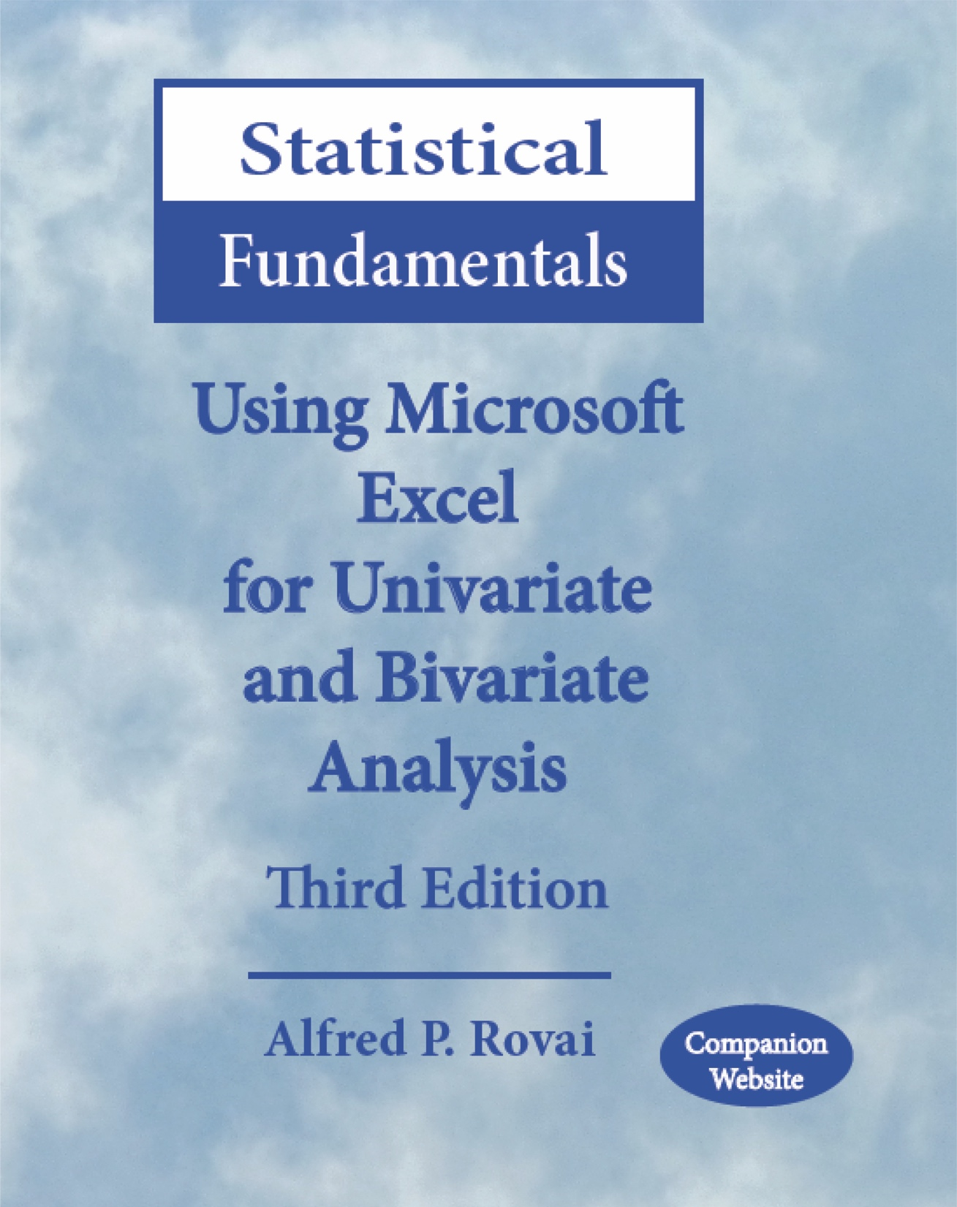
Statistical Fundamentals: Using Microsoft Excel for Univariate and Bivariate Analysis Alfred P. Rovai
Charts Overview
PowerPoint Prepared by Alfred P. Rovai
Microsoft® Excel® Screen Prints Courtesy of Microsoft Corporation.

Slide 2
Charts
Imagery is the key to understanding statistics
Helps clarify complex data and summary statistics
Supplements the written narrative
One can create and edit a variety of charts using Excel that convey the imagery that promotes meaning and understanding of statistical results. Often, selection of chart type is subjective.
Most charts share the following characteristics
Two, axes that are drawn at a right angle
The horizontal axis is the abscissa, or x-axis
The vertical axis is the ordinate, or y-axis
The independent variable is plotted on the x-axis, and the dependent variable is plotted on the y-axis

Slide 3
Creating a Chart
1
2
3
4
5
Select the data to chart (first column includes data for the x-axis; second column includes data for y-axis)
Highlight the data
Select the type of chart, e.g., column, bar, line, pie, area, scatter, other
Insert the chart type, e.g., 2-D column, 3-D column, cylinder, cone, pyramid, other
Select the chart and modify the chart layout, as desired

Slide 4
Major Types of Charts
Line & Area Charts
Line charts and area charts are most often used to present longitudinal or time series data, arranged to display change over time, e.g., year 1, year 2, year 3, year 4.
Column & Bar Charts
Column and bar charts contain columns or bars with lengths proportional to the values that they represent. They are used to compare discrete data (i.e., various categories), with each category represented by a single bar or column.
Scatterplots
Histograms
Scatterplots are used to display the strength and direction of relationship between two continuous variables.
Histograms are used to display the frequency distribution of a continuous variable. Histograms are drawn so that the range of the data is split into equal-sized bins and plotted on the x-axis from lowest to highest values. Frequency counts for each bin are plotted on the y-axis. Histograms are frequently used to evaluate normality.
Pie charts are used to display percentage values as slices of a pie and to illustrate numerical proportions.
Pie Charts

Slide 5
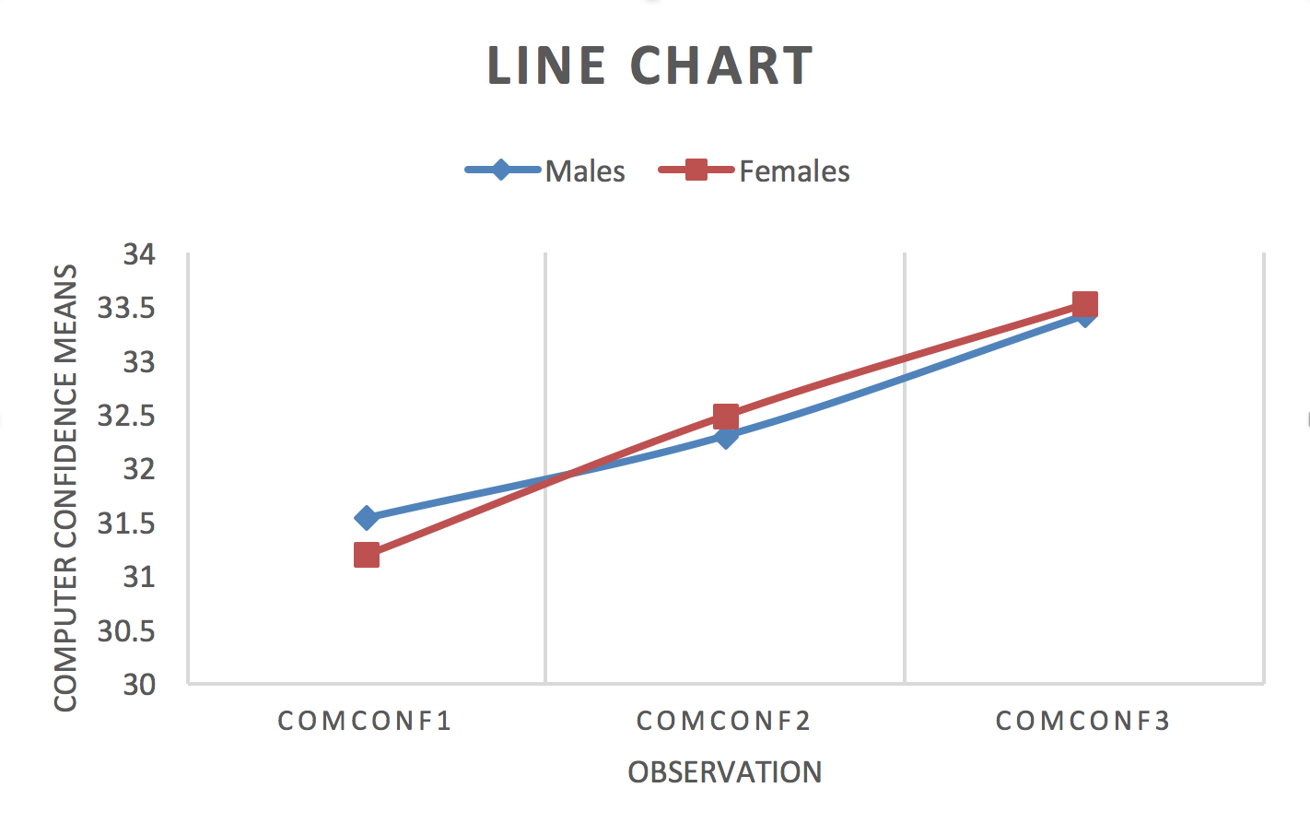
Line Charts
A line chart is used to display related categorical information as a series of data points called markers connected by straight line segments. Line charts are useful in determining trends over time that include multiple observations.
Line charts can be used to extrapolate beyond known data values (i.e., forecasting).
The above chart shows how computer confidence means change over three observations (measurements) for male and female students enrolled in an undergraduate computer literacy course. Computer confidence increases for all students during the course.

Slide 6
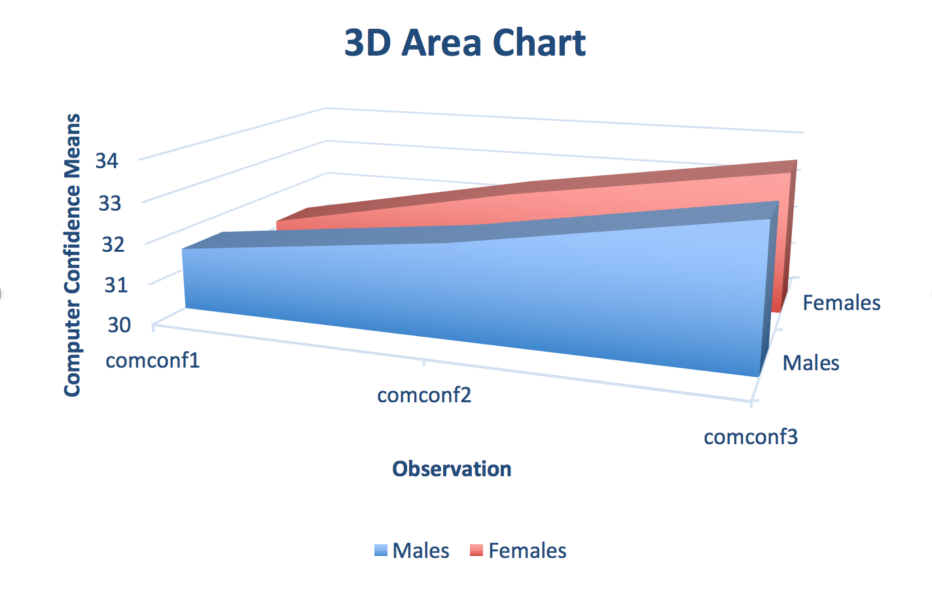
Area Charts
An area chart, based on the line chart, is used to display related categorical information as a series of data points connected by straight line segments.
Selection of an area chart over a line chart is based on the personal preference of the author.
The above chart shows how computer confidence means change over three observations (measurements) for male and female students enrolled in an undergraduate computer literacy course.

Slide 7
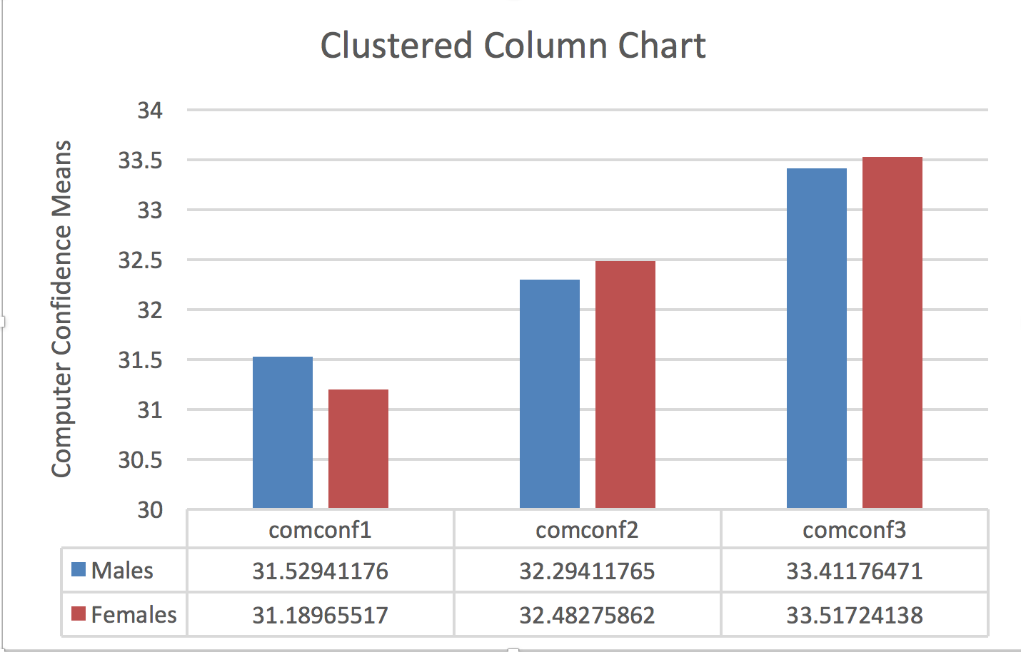
Column Charts
A column chart is used to compare categories of a categorical variable on some metric using a vertical orientation. The height of the column represents the measurement shown on the y-axis.
The above chart shows how computer confidence means for male and female students change over three observations (measurements). Included in this chart is an optional data table.

Slide 8
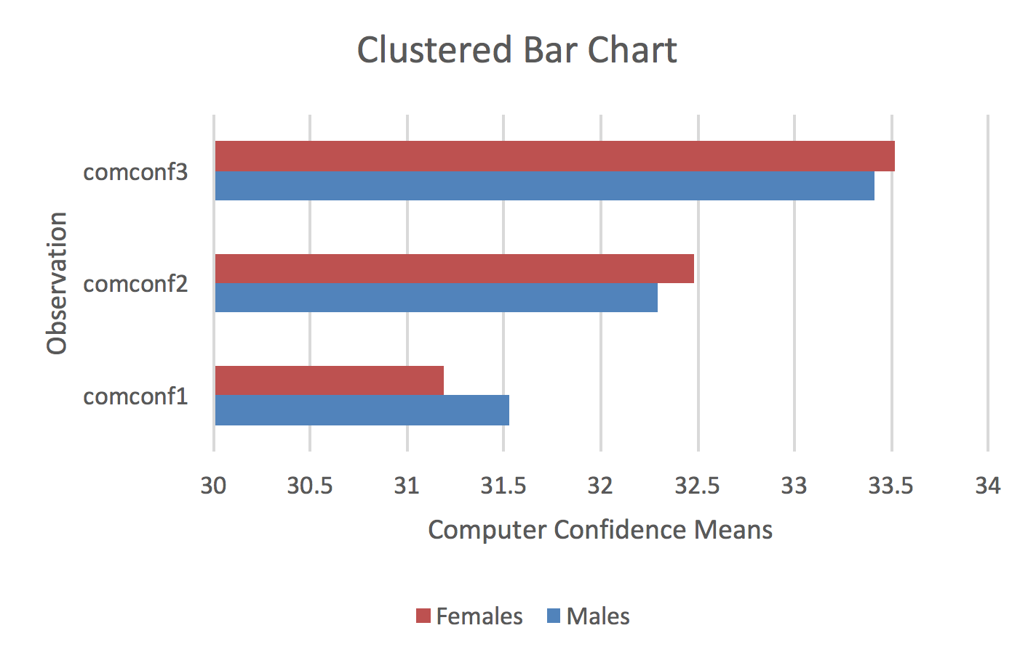
Bar Charts
A bar chart, like a column chart, is used to compare categories of a categorical variable on some metric.
A bar chart is the horizontal version of a column chart. Use the bar chart to display large text labels.
The above chart shows how female and male computer confidence scores vary over three observations (measurements).

Slide 9
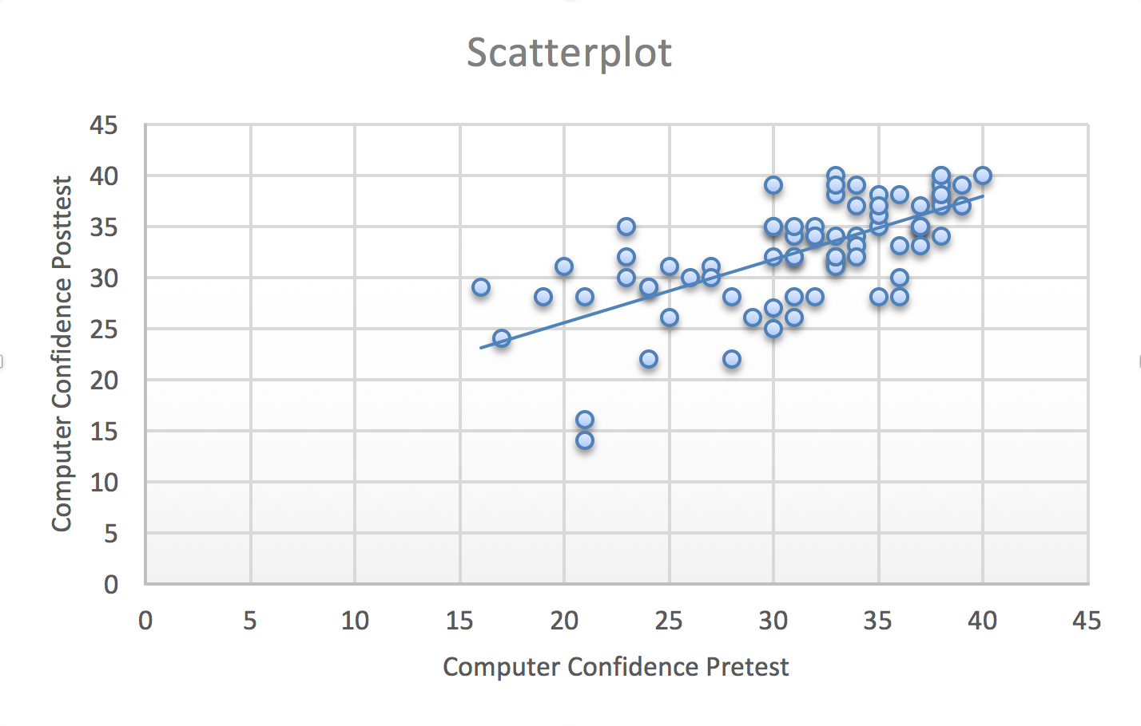
Scatterplots
Scatterplots show the relationship between two continuous variables by graphing a collection of ordered pairs (x,y). Each dot on a scatterplot represents a case. The dot is placed at the intersection of each case’s scores on the x and y axes.
The above scatterplot shows that computer confidence pretest and posttest are related because the dots are clustered together and don’t form a random or shotgun pattern.
Included is an optional trendline that shows the relationship is linear because the major axis of all the dots appears to be a straight line.
Finally, the relationship is positive – as computer confidence pretest values increase, so do computer confidence posttest values.

Slide 10
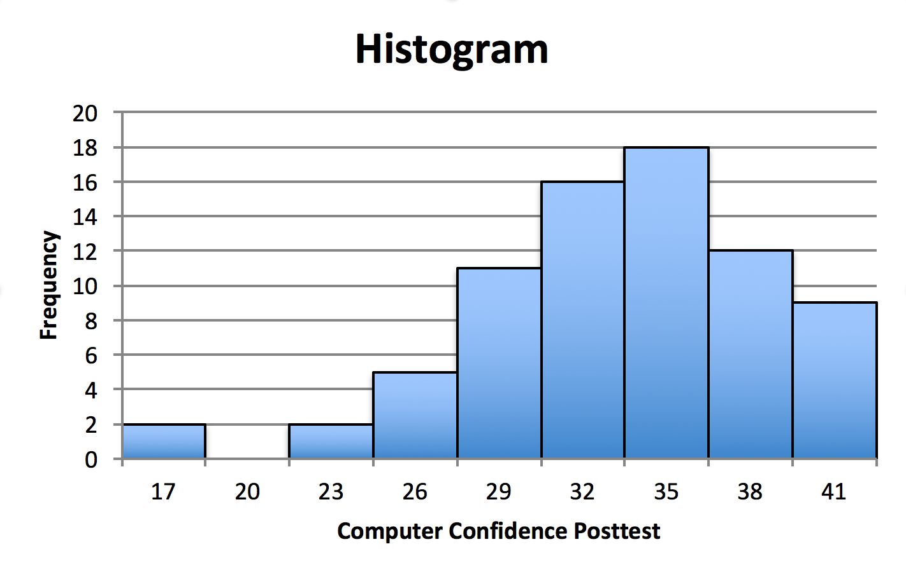
Histogram
A histogram is used to evaluate the shape of a distribution of a continuous variable.
The x-axis depicts the range of the variable from minimum to maximum scores in fixed intervals.
The y-axis depicts the number of values in each bin (column). For example, there are two scores in the first bin (scores 17 and lower) and there are zero scores in the second bin (scores higher than 17 and no higher than 20).
Histograms, unlike column charts, have no spaces between bins (columns).
The above histogram shows that computer confidence posttest scores are negatively skewed because the negative (left) tail is longer (heavier) than the right tail.

Slide 11
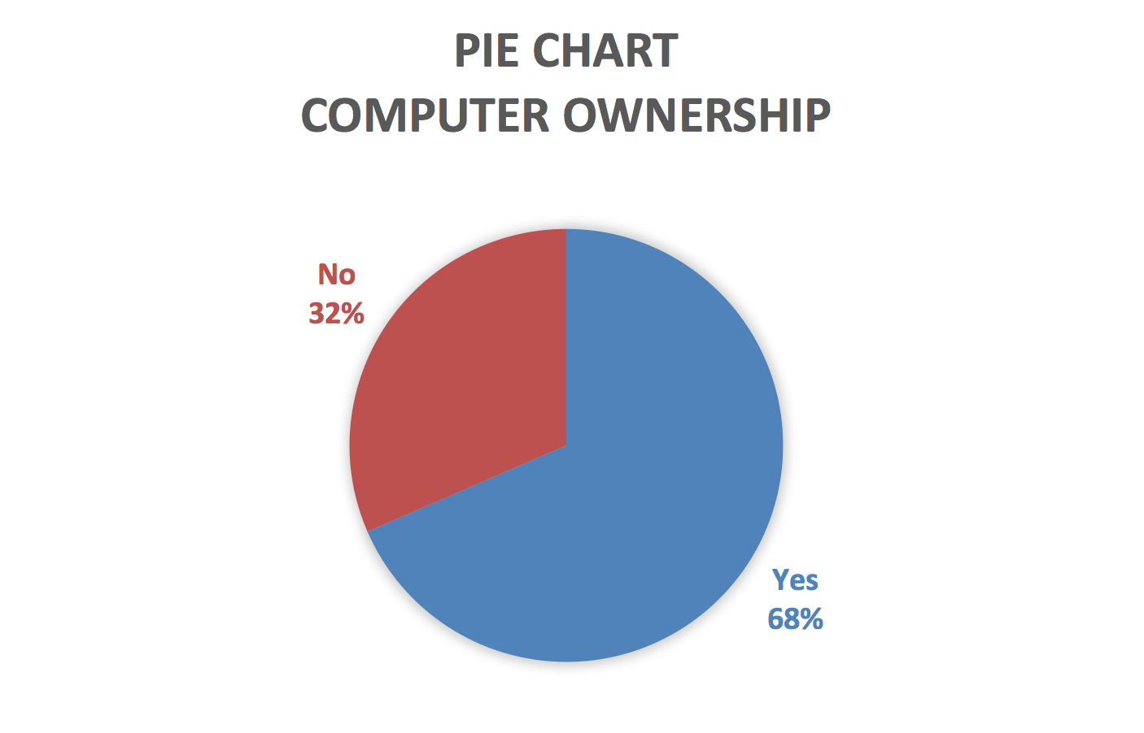
Pie Chart
A pie chart is a circular chart that is divided into sectors or slices to show approximate proportional relationships (i.e., relative size of data) to the whole at a specific point in time.
Pie charts are useful for comparing proportions and showing how data are distributed. However, a weakness of pie charts is that angles are harder to estimate for people than distances.
The above pie chart shows that 32% of respondents to a survey responded “no” to owning a computer and 68% responded with a “yes.”

Slide 12
Charts Overview
End of Presentation

